Slide 1
Native Americans (Indians) Today
Ariel Peasley
Education Coordinator
Coos History Museum
Notes:
Vocab list: Stereotype, Regalia, Time Immemorial, Federally Recognized Tribe, Confederated Tribe

Slide 2
Which federally recognized Native American tribes have offices in Coos County today?
Hint: there are two

Slide 3
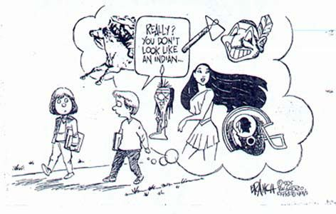
Stereotype: a false idea about a whole group of people based on just a little information

Slide 4
What is a false idea? Has anyone ever had a false idea about you, what was it? What other stereotypes might Native Americans experience?

Slide 5
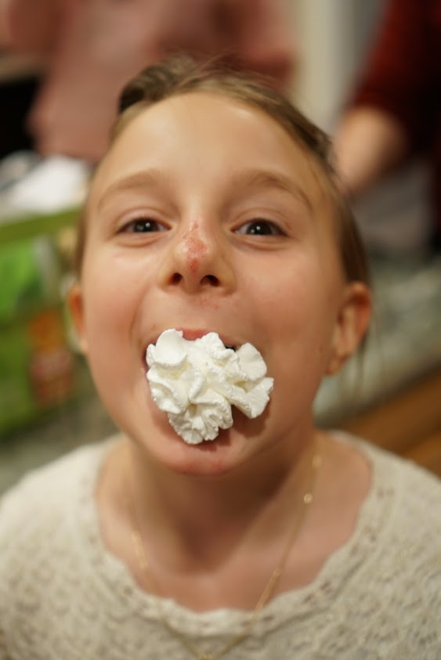
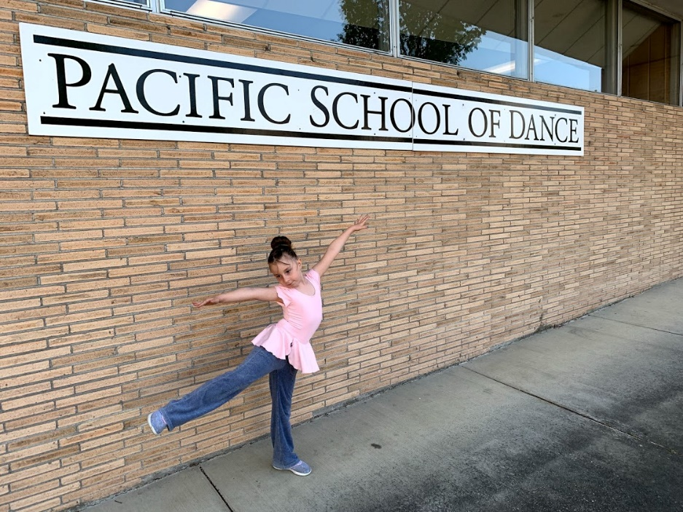
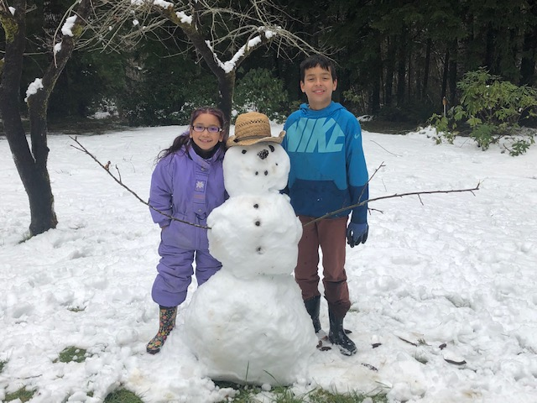
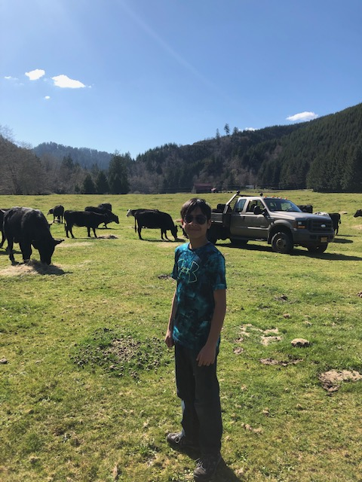
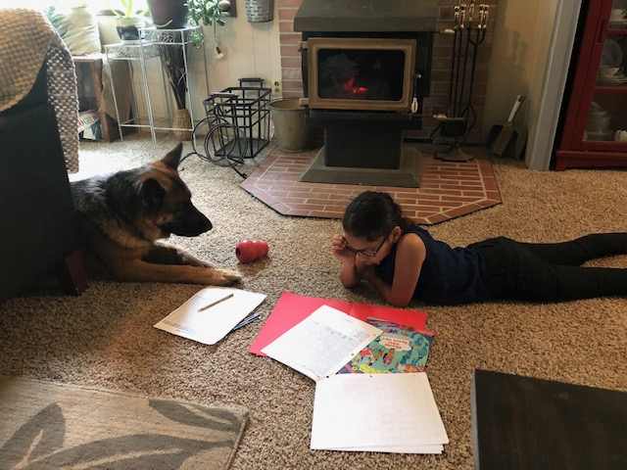
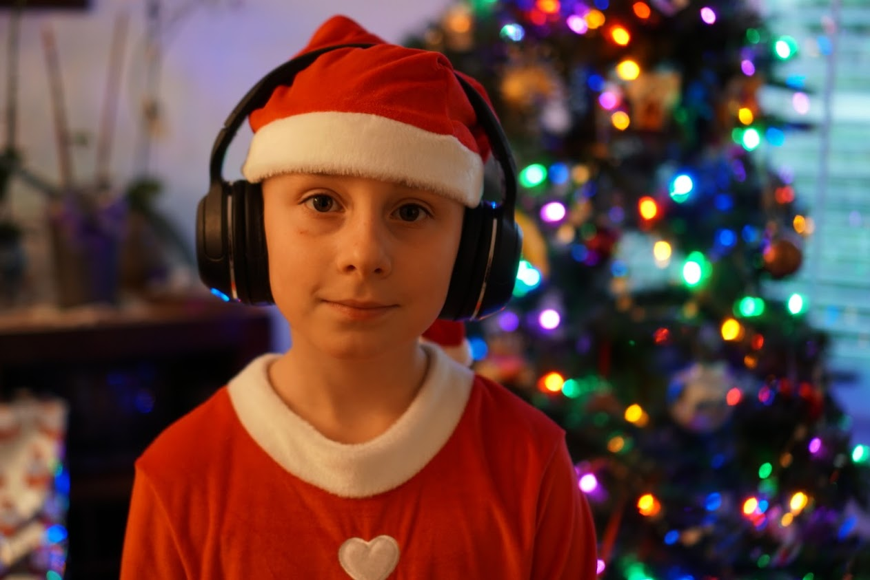

Slide 6
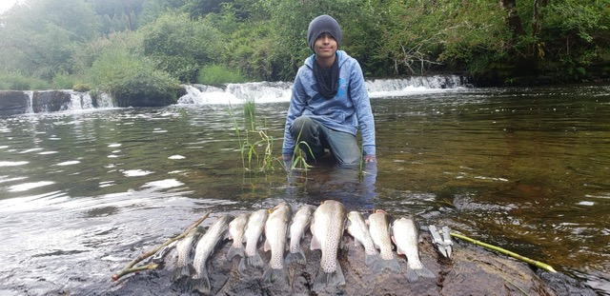
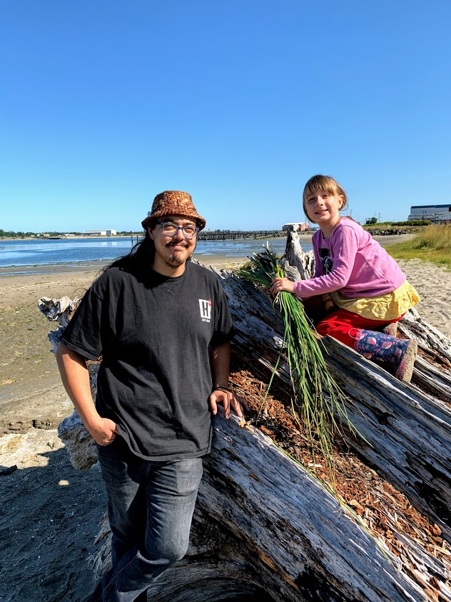
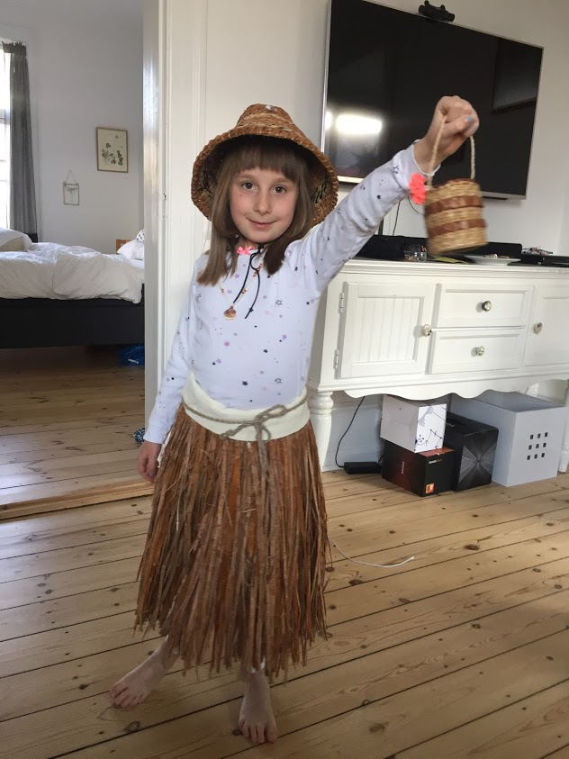
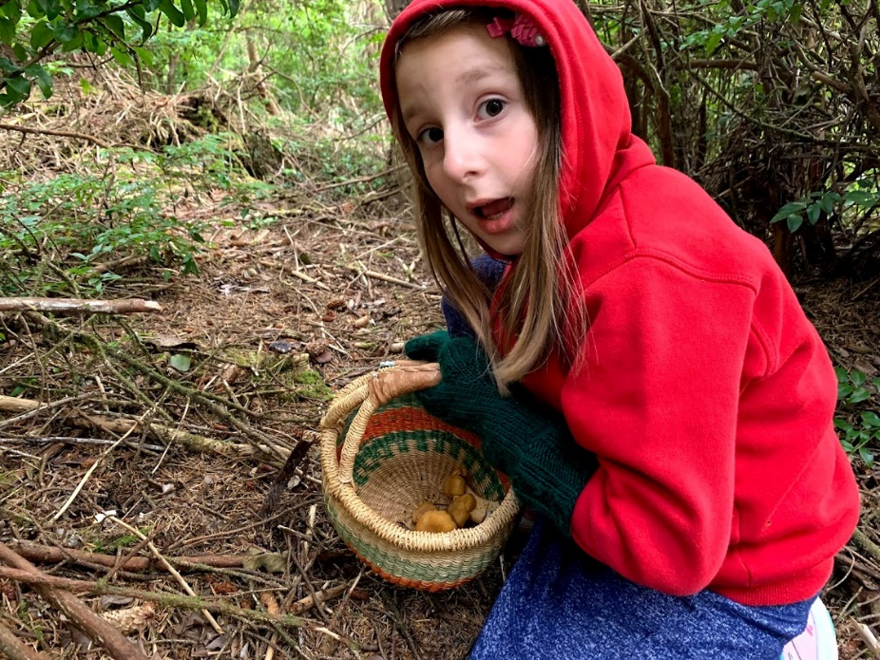

Slide 7
What activities or celebrations do you put on fancy clothes for?

Slide 8
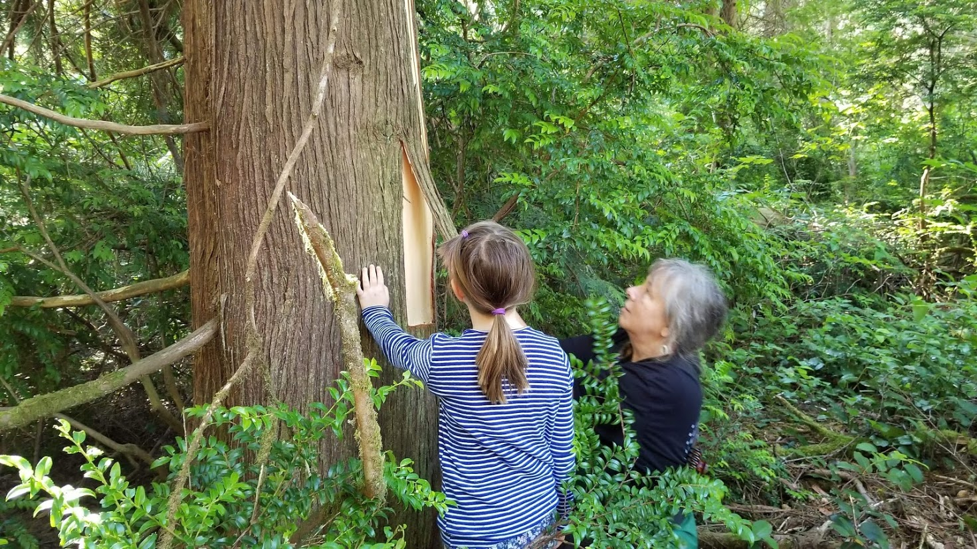
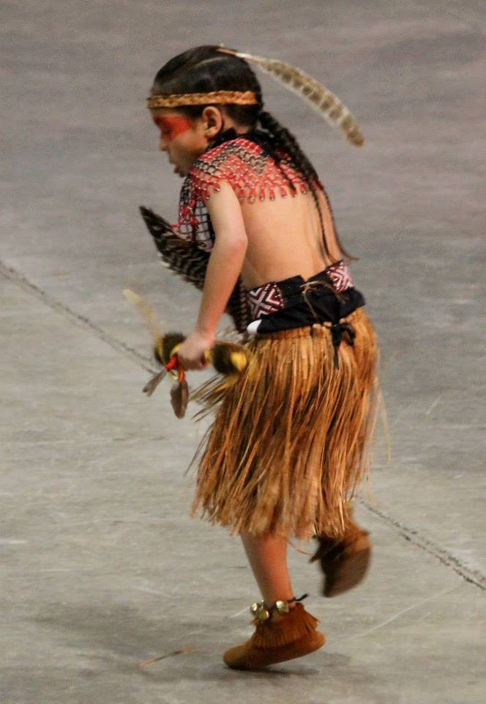
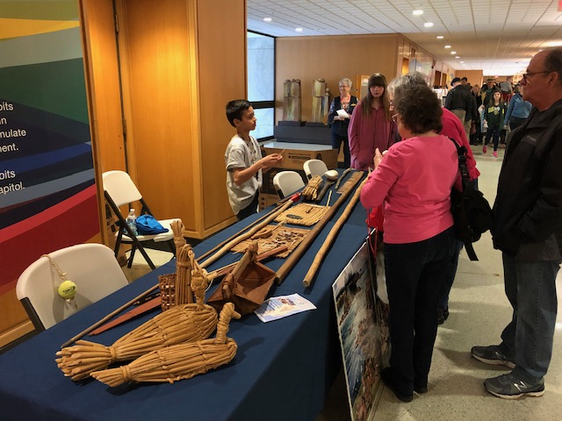
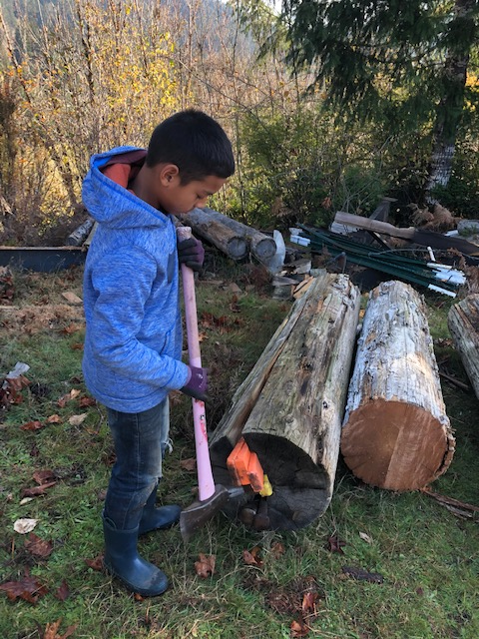

Slide 9
What are some things that Matilda, Ramil, and Zhade do that are similar and different from what you do?

Slide 10
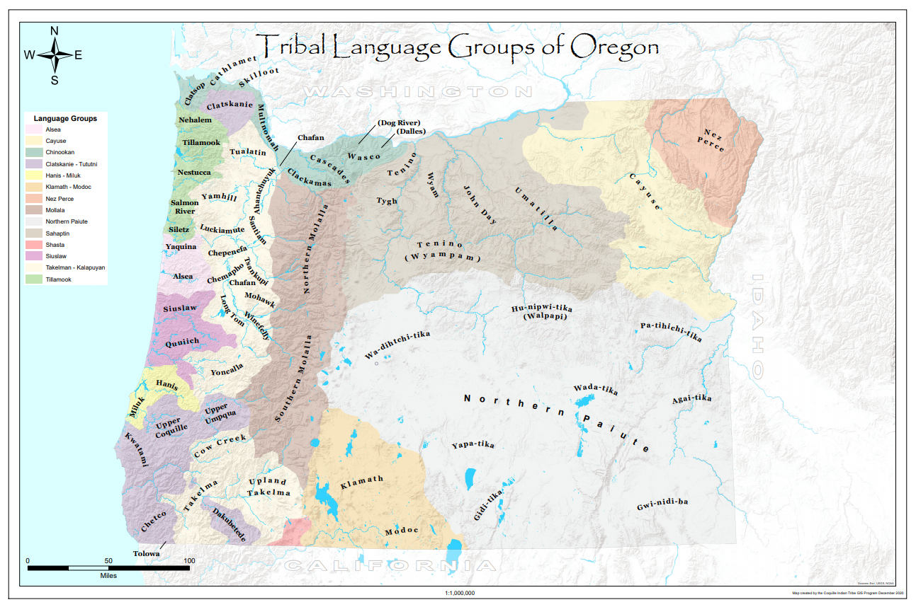

Slide 11
Let’s Practice
“Hello”
In Miluk: “Dai”
Sounds like – DIE
In Athabaskan: “Jala”
Sounds like – JALA

Slide 12
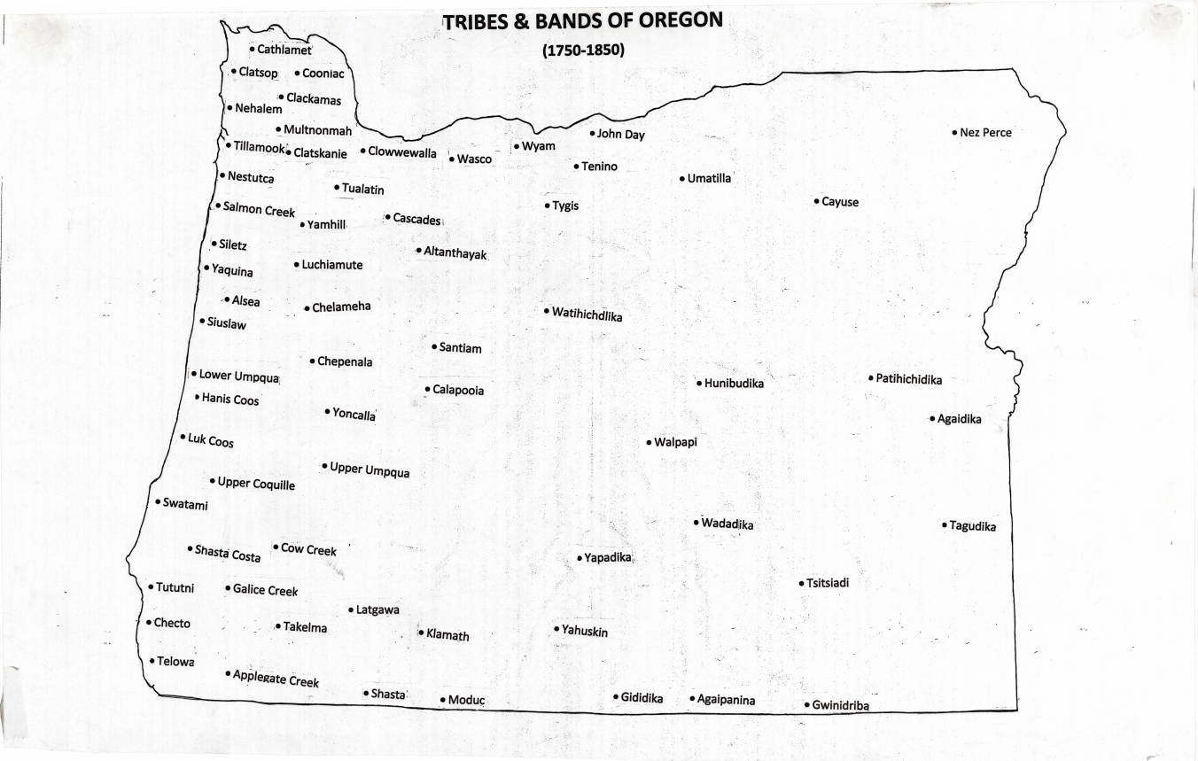

Slide 13
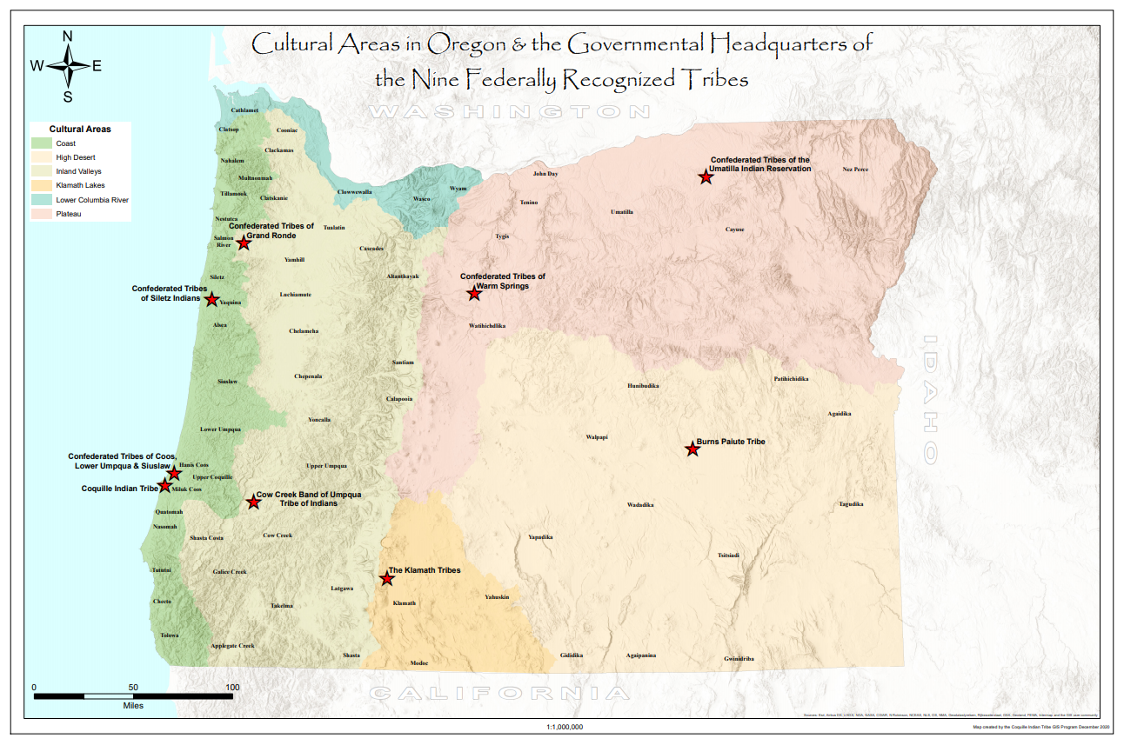

Slide 14
What is a Federally Recognized Tribe? What do you think it means to be a Confederated Tribe?

Slide 16
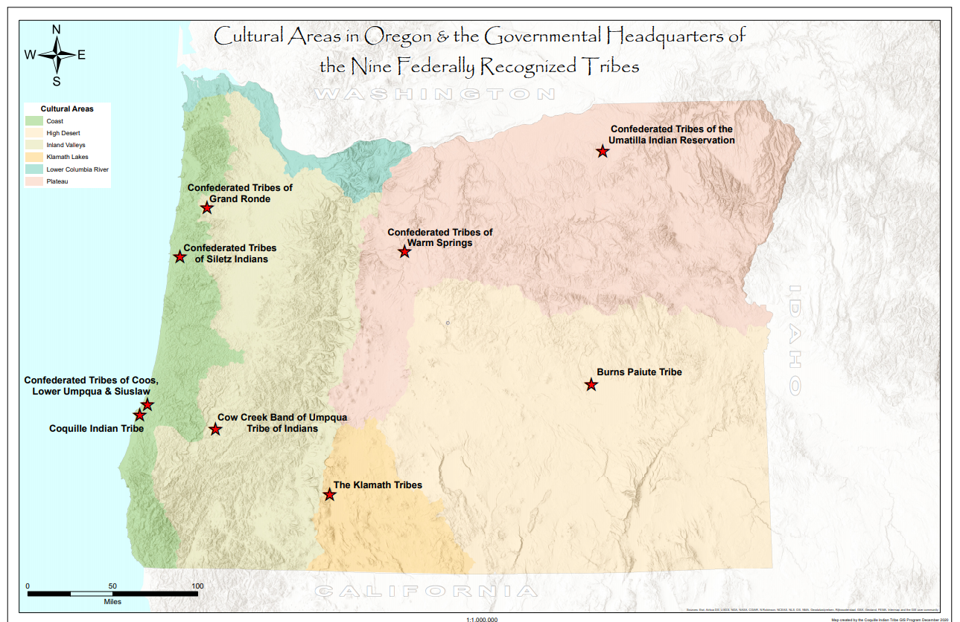

Slide 33
What would you put on a logo about you and your family?

Slide 35
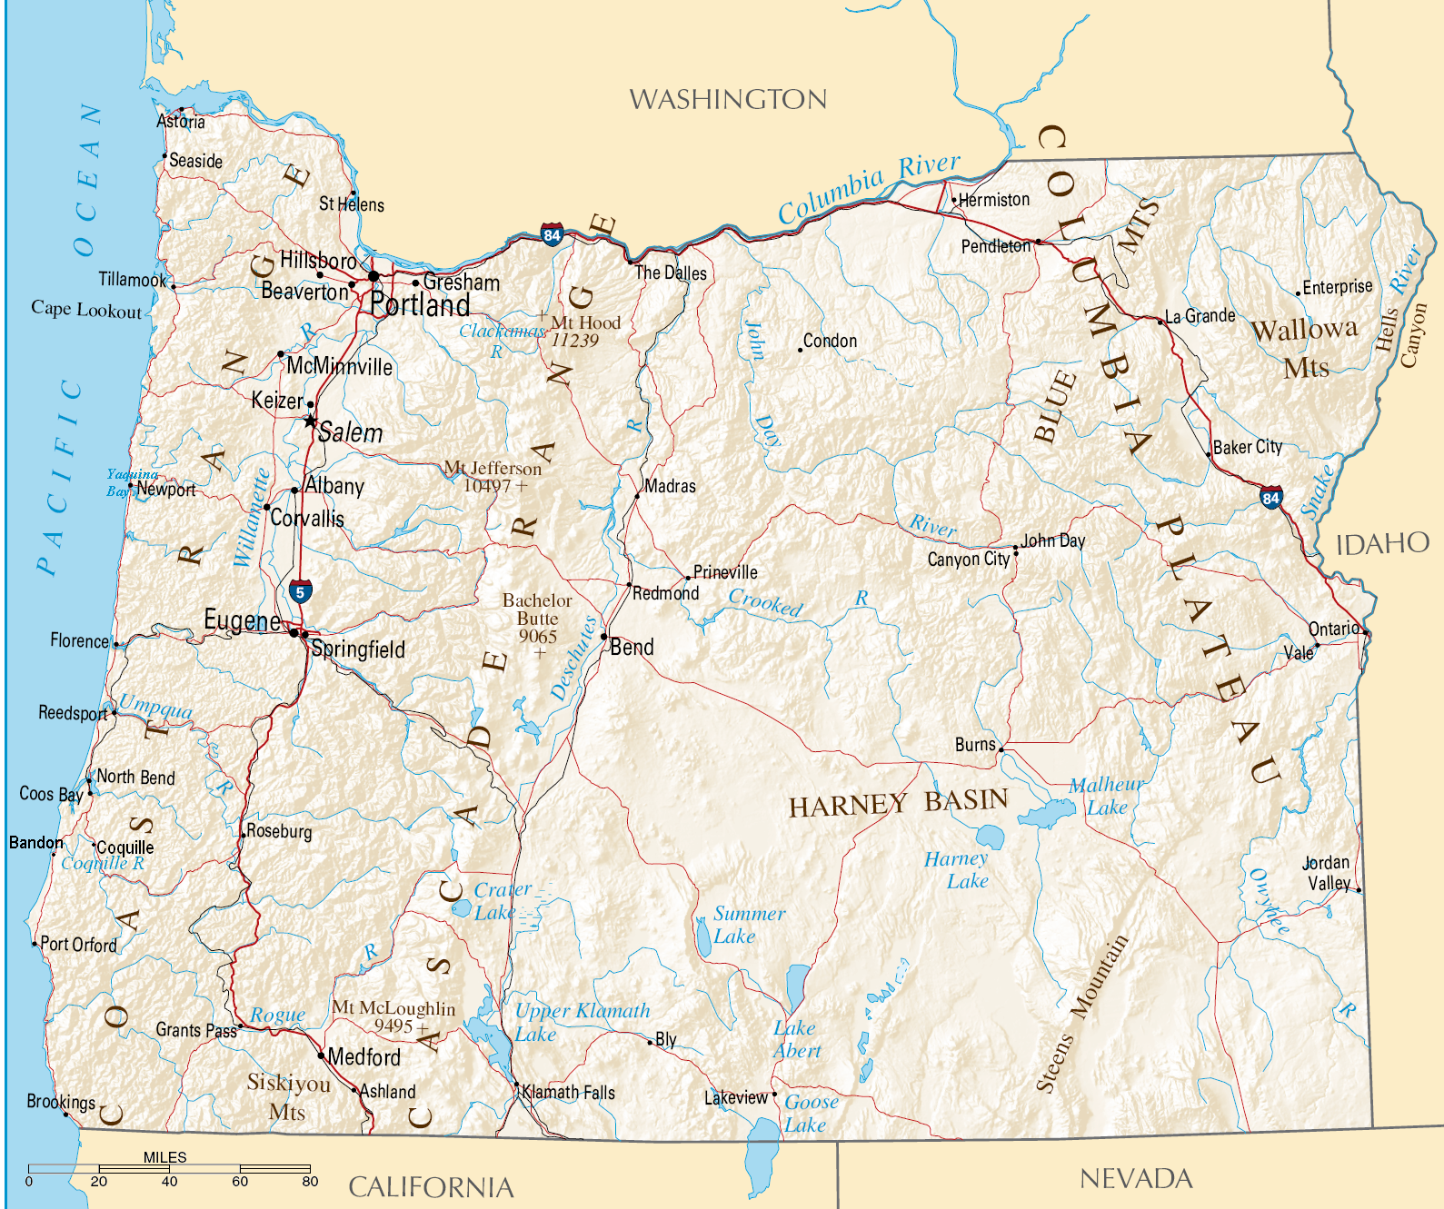
Siletz
Notes:
35
Dear Coos County 4th graders,
I’m a Siletz tribal member in the 4th grade at Siletz Valley charter School in Siletz, Oregon. We learn about regular school subjects…

Slide 36
Dear Coos County 4th Graders,
I'm a Siletz tribal member in the 4th grade at Siletz Valley Charter School in Siletz, Oregon. We learn about regular school subjects, and also have members of our tribe teach about our tribal culture, so we can teach our own kids when we grow up. Today at school we are writing letters about what we plan to do for Spring Vacation.

Slide 37
Some of the time I'll probably go the Youth Center to play video games, do crafts, or watch movies, but some of the time I'll be with my family while we carry on our tribal traditions. My uncles may take me with them to the Siletz River to collect lamprey eels. In the evening we build a small fire by the water so we can see the lamprey trying to crawl upriver in the dark.

Slide 38
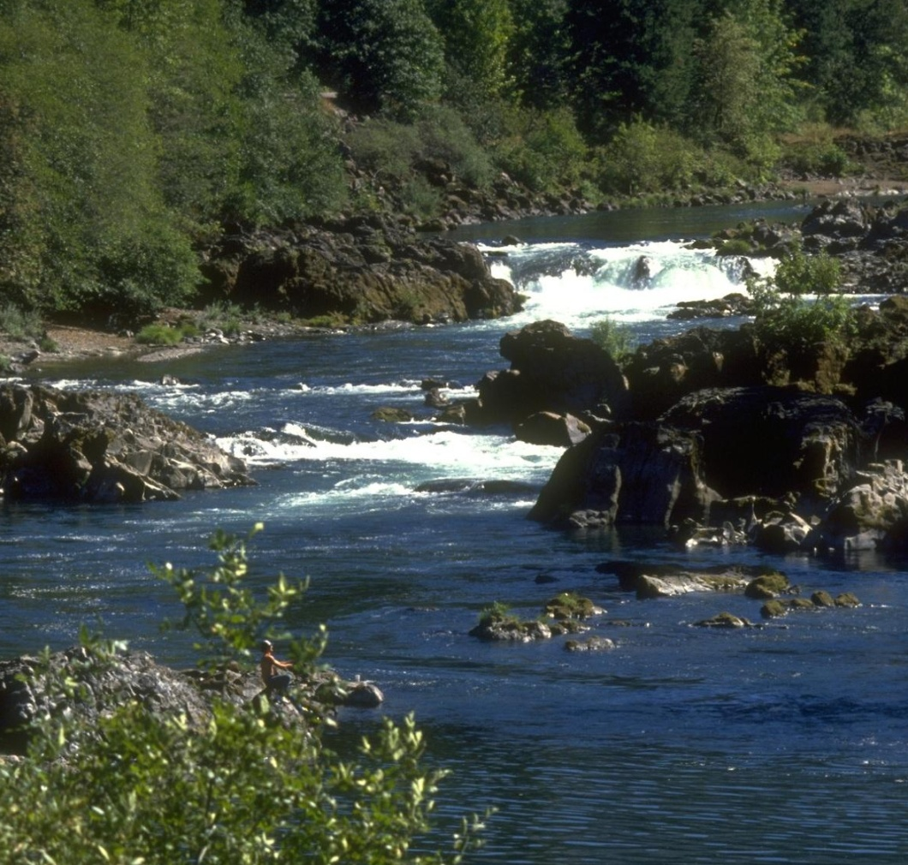
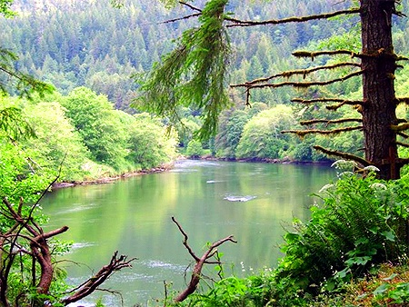
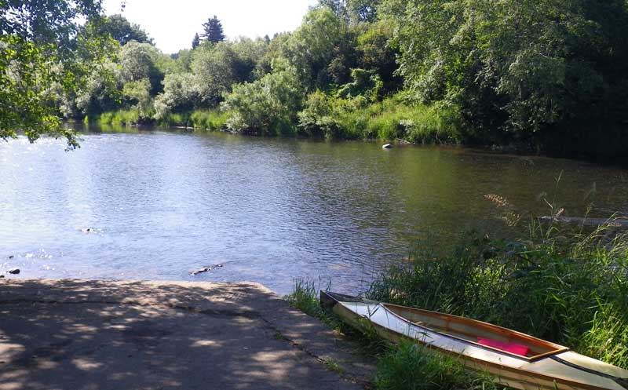
Notes:
38
And also have members of our tribe teach about our tribal culture,
so we can teach our own kids when we grow up.
Today at school we are writing letters about what we plan to do
for Spring Vacation. Some of the time I’ll probably go to…

Slide 39
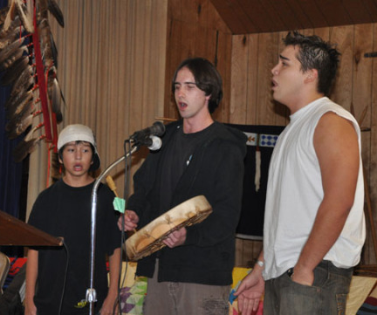
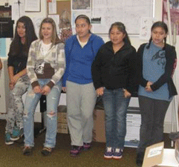
Notes:
…the youth center to play video games, do crafts, or watch movies,
but some of the time I’ll be with my family and we’ll carry on some of our tribe’s traditions.
My uncles may take me with them to the Siletz River to collect lamprey eels.
39

Slide 40
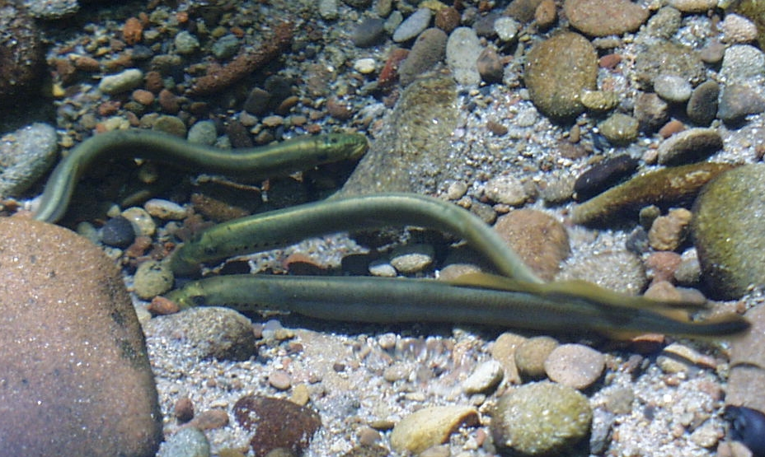
Notes:
In the evening, we build a small fire by the water so we can see the lamprey trying to crawl uprivier
40

Slide 41
Sometimes we can grab them with our hands, but it's always good to have a long stick with a hook on the end to pull them out from their hiding place under the rocks. We clean and smoke them, and eat them at a feast at the beginning of summer. Sometimes we can catch steelhead to smoke and eat. I LOVE smoked fish!

Slide 42
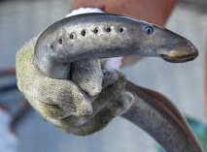
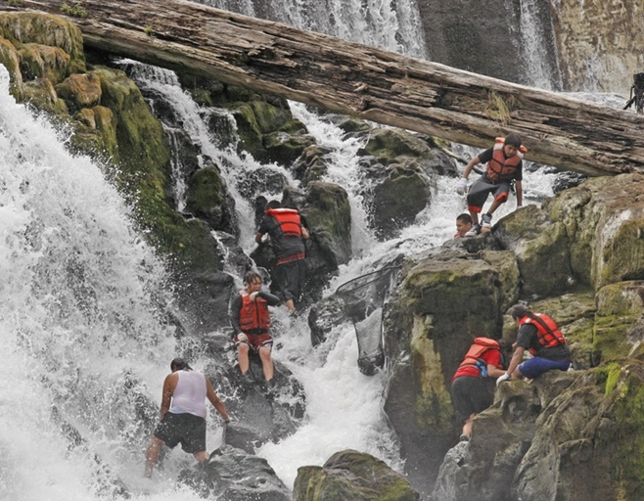
Notes:
42
…Sometimes we can grab them with our hands, but they’re slippery! They like to hide under rocks…

Slide 43
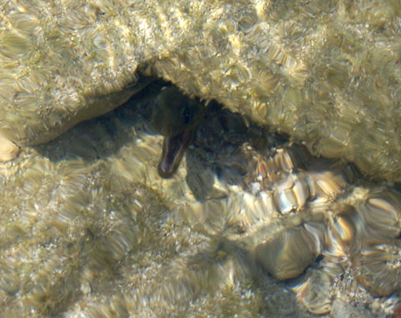
Notes:
…so it’s always good to have a long stick,
with a hook on the end
to pull them out from their hiding place.
We clean and smoke them…
43

Slide 44
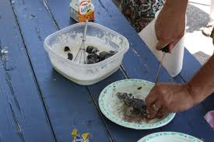
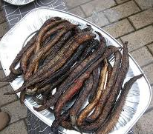
Notes:
44
…and eat them at a feast at the beginning of summer. Sometimes we can catch steelhead to smoke and eat. I LOVE smoked fish!
A bunch of us may also get asked to go to the woods with my Mom and my aunts…

Slide 45
A bunch of us may get asked to go to the woods with my Mom and my aunts to help peel and carry home bundles of bark pulled from cedar and maple trees. We take the bark from only one section of a tree, so it doesn't die. Afterwards they peel away the soft inner layer of bark, and weave it into skirts and dresses to wear at special traditional ceremonies.

Slide 46
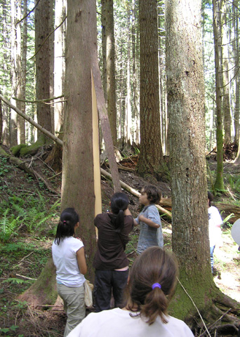
Notes:
46
…to help peel and carry home bundles of bark from cedar and maple trees. We take the bark from only…

Slide 47
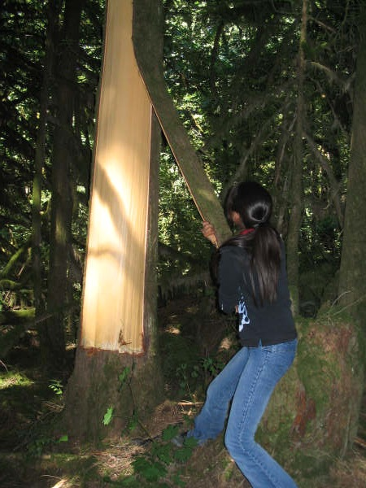
Notes:
…one section of tree so it doesn’t die.
Afterwards, they peel away the soft inner layer…
47

Slide 48
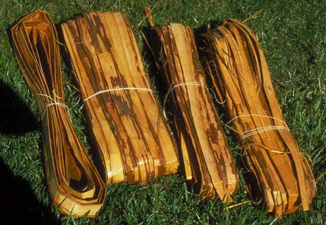
Notes:
…of bark and weave it into skirts and dresses
to wear at tradtional ceremonies.
Sometimes my Mom has us….
48

Slide 49
Sometimes my mom has us help dig up spruce roots, or cut hazel for the basketweavers. They have to split and treat the fibers before they can use them for weaving. It takes a really long time to learn how to make anything like a basket!

Slide 50
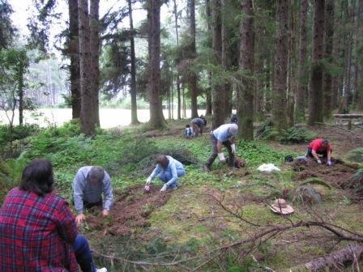
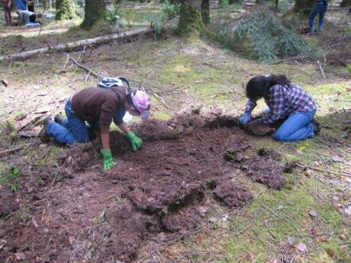
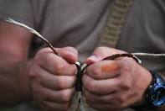
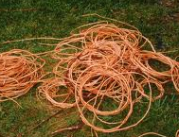
Notes:
50
…help her dig up spruce roots or cut hazel for the basketweavers.
They have to split and treat the fibers before they can use them.
It takes a really long time to get ready,
and even longer to learn how to make a good basket!
If the weather is good, we might go visit some Indian friends in Coos Bay.

Slide 51
If the weather is good, we might go visit some Indian friends in Coos Bay. Sometimes we all go clamming. It's fun to look at us on the mudflats and realize we're doing pretty much exactly what our people did here thousands of years ago.

Slide 52
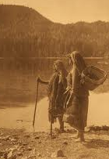
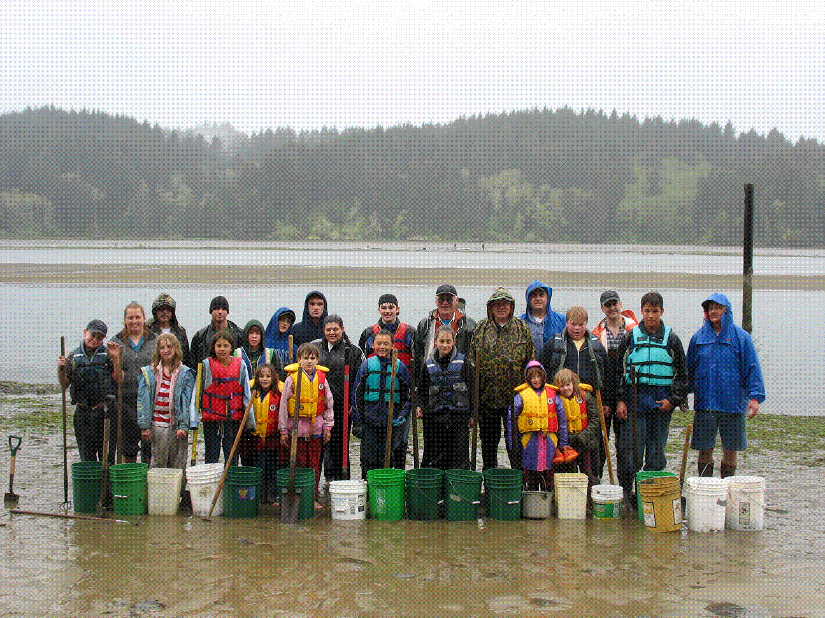
Notes:
Sometimes we can go clamming there. It’s fun to look across at everyone on the mudflats
and realize we’re doing pretty much exactly what our people were doing here thousands of years ago.
Also this year, my cousins and I will be old enough to dance at NAY-dosh,
52

Slide 53
Also this year, my cousins and I will be old enough to dance at NAY Dosh, just as my great-great-great grandparents did. Nee-dash is a big celebration to honor the place where we live, and our people's place in the world. The grown-ups stay up dancing and singing and talking all night for several days in a row.

Slide 54
Kids my age and younger are allowed to dance on just one night. For weeks before my Mom and my aunts teach the dancing and singing, and help the girls put on the cedar bark and maple bark dresses and fancy regalia.

Slide 55
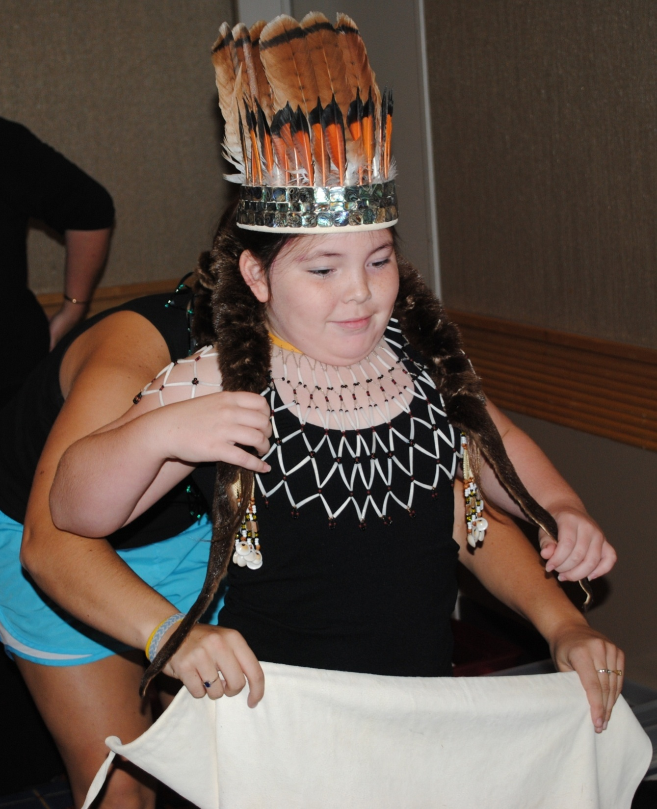
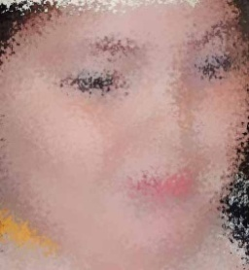
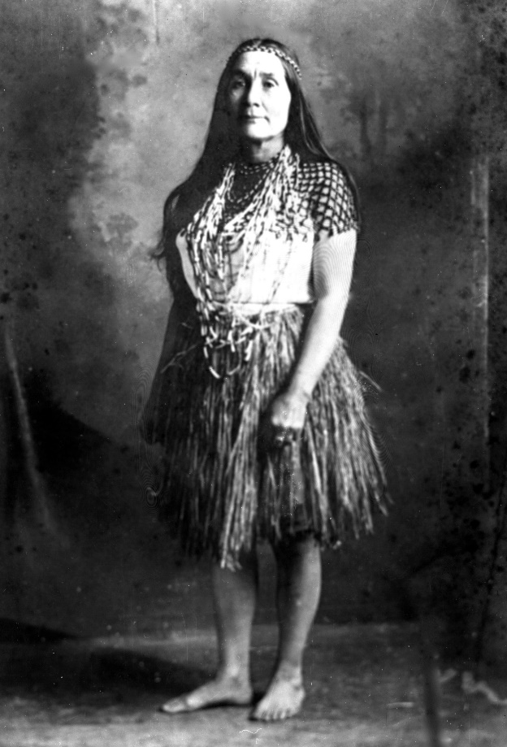
Notes:
55
…just as my great-great-great grandparents did.
NAY-dosh is a big celebration to honor the place where we live, and our people’s place in the world.
The grown-ups stay up singing and dancing and talking all night for several days in a row.
Kids my age and younger are allowed to dance on just one night.
For weeks before, my Mom and my aunts teach the dancing and singing, and then help the girls put on cedar and maple bark dresses and regalia.
So, I think Spring Vacation will be pretty busy and lots of fun. I’ll get to do regular things like most kids, and also some of the really cool things that make me a part of my tribe.
Sincerely,
Siletz Tribal Student.
DISCUSSION:
What did this student write about?
What interested you? Did anything surprise you?
Do any of you go salmon fishing, or crabbing?
Have you ever seen a lamprey eel?

Slide 56
So, I think Spring Vacation will be pretty busy and lots of fun. I'll get to do regular things like most kids, and also some of the really cool things that make me part of my tribe.
Sincerely,
Siletz Tribal Student

Slide 58
Can you Relate?
How do some of these traditions remind you of things you do with your friends, family, or community?
Do you have rituals and traditions special to you?
Notes:
https://kahoot.it/v2/
07043436
https://kahoot.it/challenge/07043436?challenge-id=1a21d248-425a-451f-b38d-d12bb15fc208_1608238043725

Slide 59
Conclusions
What was new to you?
How are Native Americans living today?
What would you like to know more about?

Slide 60
Chiloquin
Notes:
60
Hello from a Klamath 4th grader!
My school is north of Klamath Lake, in Chiloquin.

Slide 61
Hello, Coos County 4th Grade Class,
My school is north of Klamath Lake, in Chiloquin. My class is writing about what we’re going to do for Spring Vacation.
My family belongs to the Klamath tribe, and March is when we have two very important Tribal events that we all work on.

Slide 62
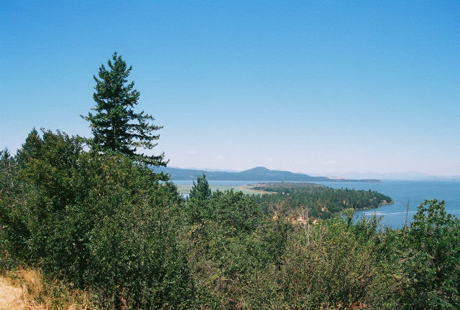
Notes:
62
My class is writing about what we’re…

Slide 63
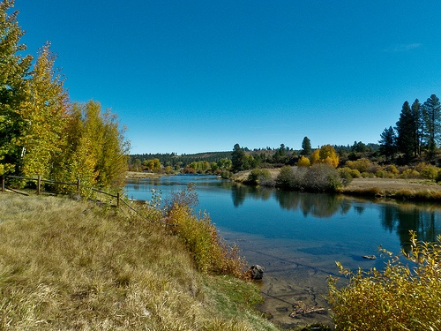
Notes:
…going to do for Spring Vacation.
My family belongs to the Klamath Tribe,
63

Slide 64
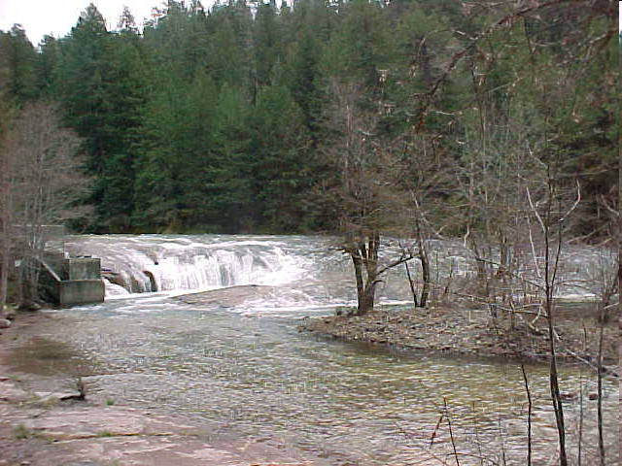
Notes:
…and March is when we have two very important Tribal events that we all work on.
First, we get ready for the annual C’waam ceremony.
C’waam is…
64

Slide 65
First, we get ready for the Annual C’waam Ceremony. C’waam is a kind of fish that some people call the “Lost River Sucker.” It's about the size of a salmon, and is as important to us as salmon is to the coastal tribes. We have a big C'waam celebration with dancing and drumming in March, because that's when the fish swim up the river to spawn.

Slide 66
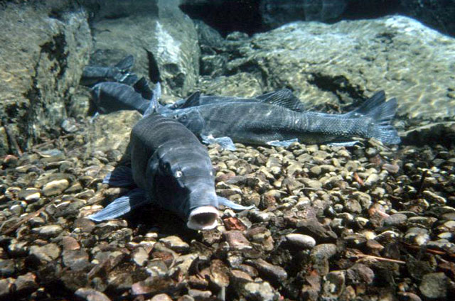
Notes:
…a kind of fish that some people call the “Lost River Sucker.” It’s about the size of a salmon…
66

Slide 67
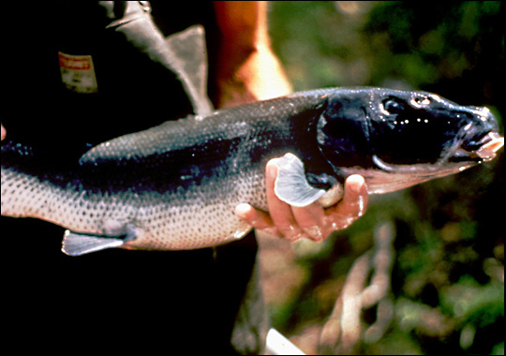
Notes:
…and is as important to us as salmon is to the coastal tribes.
We have a big C’waam celebration…
67

Slide 68
In the old days that’s when people would be able to catch and smoke and dry enough to have at ceremonies and feasts all year long. My family will be getting ready to perform because we are some of the drummers and dancers at the celebration this year.

Slide 69
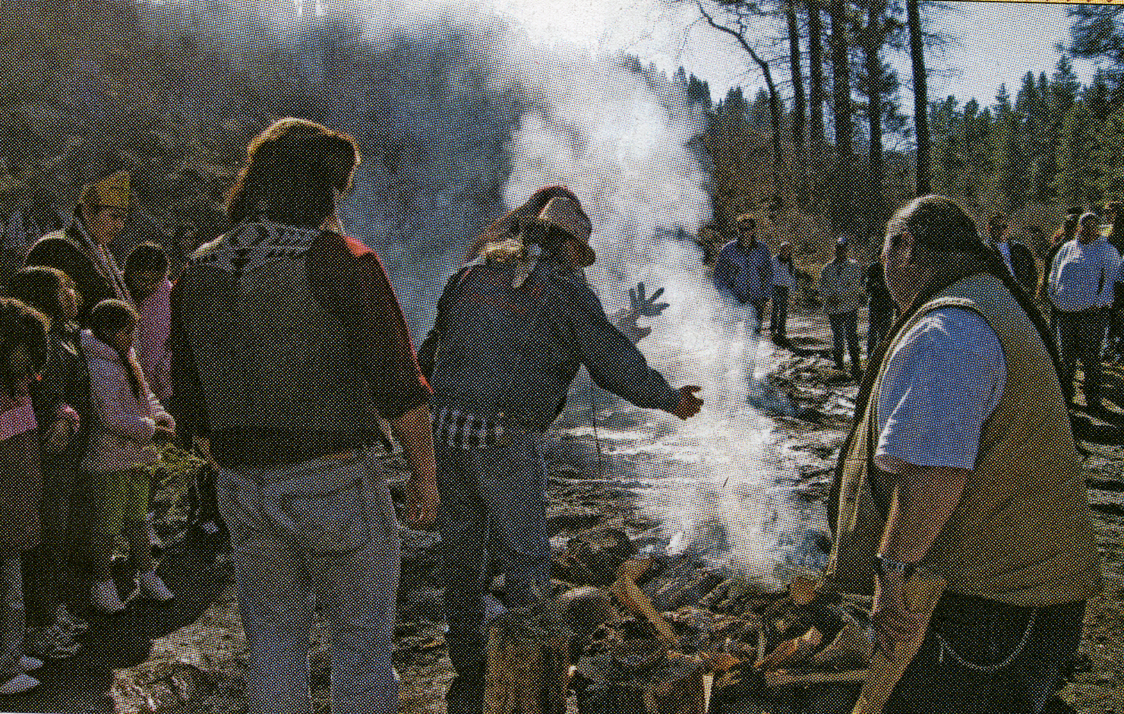
Notes:
69
…with dancing and drumming in March, because that’s when the fish swim up the river to spawn.

Slide 70
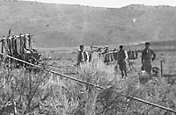
Notes:
In the old days that’s when people would be able to catch and smoke and dry enough to have at ceremonies and feasts all year long.
My family will be getting ready…
70

Slide 71
Notes:
…to perform because we will be some of the dancers and drummers at the celebration this year.
The other big thing that happens in March is the Peak to Peak World Championship Basketball Tournament hosted by my tribe.
71

Slide 72
The other big thing that happens in March is the Peak to Peak World Championship Basketball Tournament hosted by my tribe. We’ve held the tournament in Chiloquin for almost 60 years, and used to call it the Indian World Championships because we invite tribes from other states.

Slide 73
Notes:
We’ve held the tournament for more than 60 years, with teams from tribes in other states, and it’s great because everybody can get together to play and just hang out. Basketball is really popular with a lot of tribes, maybe because it’s similar in some ways to a game that our ancestors used to play. In fact the Siletz high school boys team won a state championship last spring. We have pictures of…
73

Slide 74
Basketball is really popular with a lot of Indian tribes, maybe because in some ways it is similar to a game our ancestors played, and because everyone is together playing and hanging out. In fact, the Siletz high school boys won a state championship last spring. We have pictures of my Dad and my grandfather when they played, and a lot of other family members.

Slide 75
Notes:
75
My Dad and my grandfather when they were young and played.

Slide 76
Sometimes some of my friends ask me if I ever get tired of doing cultural and traditional things. I think doing those things is just a part of who I am. My mom says I’ve been part of these traditions since before I could walk, and that they will always be a part of me. So, I have traditions from both sides of my family. My Mom is the dancer and drummer side. My Dad is the basketball team side. Both my Mom and Dad say that playing good basketball is a lot like dancing. I hope you have a good Spring Vacation.
- Klamath Tribal 4th grader.

Slide 77
Notes:
77
Sometimes some of my non-tribal friends ask if I get tired of helping with
some of the traditional things , but I guess I feel as though that’s
just part of who I have always been. My Mom says that was
true from the time I was born. So I have traditions from both
sides of my family: my Mom is more of the dancer and drummer,
and my Dad is part of the teamwork of basketball. Both of them say
that there’s a lot that’s the same between dancing and basketball
and those are some of the things that are part of our traditions.
I hope you have good spring vacation.
Klamath 4th grader.
DISCUSSION:
What kinds of things did this student write about?
What was your favorite part? most interesting?
Did the student write about any traditions?
What kinds of traditions do you know of? (things you always do at a certain
time/with certain people, e.g., fireworks on 4th, turkey at Thanksgiving,
going camping)
Has anyone ever seen or fished for a suckerfish?
(geography variety around state, different fish/animals)

Slide 78
Can you Relate?
How do some of these traditions remind you of things you do with your family, friends, or community?
Do you have rituals and traditions special to you, what are they?
Notes:
https://kahoot.it/v2/
07043436
https://kahoot.it/challenge/07043436?challenge-id=1a21d248-425a-451f-b38d-d12bb15fc208_1608238043725

Slide 79
Conclusions
What was new to you?
How are Native Americans living today?
What would you like to know more about?

Slide 80
Warm Springs
Notes:
80
Dear Coos County 4th graders,
I am a fourth grader at Warm Springs Elementary School,
on the Warm Springs Reservation

Slide 81
Dear Coos County 4th Graders,
I am a fourth grader at Warm Springs Elementary School, on the Warm Springs Reservation. Today my class is writing about what we expect to do during Spring Vacation.
I will get to spend it with my grandparents, who are Elders of my tribe. They know a lot about our tribe’s culture, and sometimes I get to help them do traditional things so I can learn at least some of what they know.

Slide 82
Notes:
Today my class is writing about what…
82

Slide 83
Notes:
…we expect to do during Spring vacation.
I will get to spend it with my grandparents, who are Elders of my tribe
83

Slide 84
Notes:
84
They know a lot about our tribe’s culture, and sometimes
I get to help them do traditional things so I can learn
at least some of what they know.

Slide 85
Just as people today cook and eat potatoes or carrots, my ancestors dug and ate the roots of other plants that grow here. Biscuit root is one of those plants. My Grandma knows how to find them even when they have no leaves or flowers. The root looks like a flower bulb. We peel and clean them after they’re dug, and put them away for later. They taste kind of sweet.

Slide 86
.
Notes:
86
Just as people today cook and eat potatoes or carrots, my ancestors dug and ate the roots of other plants that grow here.

Slide 87
Biscuit Root
Notes:
87
Biscuit root is one of those plants. My grandma knows
how to find them…

Slide 88
Notes:
88
…even when they have no leaves or flowers.
The root looks like a flower bulb. We…

Slide 89
Notes:
…peel and clean them after they’re dug, and
put them away for later. They taste kind of sweet.
My grandpa usually lets me help fix…
89

Slide 90
My Grandpa usually lets me sit and help fix his salmon fishing nets, and we go fishing if the weather is good. He starts fishing for salmon and lamprey eels in the springtime and keeps fishing all summer long.

Slide 91
Notes:
91
…his salmon fishing nets, which are like ones my ancestors used. We’ll go fishing if the weather is good. He starts fishing for salmon and lamprey eels in the springtime, and keeps fishing all summer long.

Slide 92
In the spring he mostly uses a dip net to catch fish where they jump over rapids and waterfall. He says this is one of the ways they caught fish thousands of years ago. Grandpa saves the first salmon he catches in springtime for a special feast. In the summer, we take out his boat on the river and fish in deep pools. My Dad and my uncles also fish for salmon in the summertime. Usually, we smoke some of the fish, and the rest we put in the freezer for later.

Slide 93
Notes:
In the spring he mostly uses a dip net to catch fish where they jump over rapids and waterfalls,
the same way they did thousands of years ago.
He saves the first salmon he catches each spring for a special feast.
93

Slide 94
Notes:
94
In the summer, we take his boat out on the river
to fish in deep pools. My Dad and uncles fish for salmon in summer, too.

Slide 95
Notes:
95
Usually, we smoke some of the fish, and put the rest in the freezer for later.
My cousins, who are members of the Umatilla Indian Tribe in Pendleton, will probably come visit their grandparents here during spring break. We will probably get together…

Slide 96
My cousins, who are members of the Umatilla Indian tribe in Pendleton, will probably come visit their Grandparents here during spring break. We will probably get together for some basketball. They are really good, in fact a girl name Shoni Schimmel from the Umatilla Tribe plays for the University of Louisville and was named an All-American.

Slide 97
Another first for Shoni Schimmel, making the first team of the Full Court Press freshman All-America team, averaging 15.1 points and 4.9 assists per game during her first season with the University of Louisville women’s basketball team.
Notes:
97
…for some basketball. They’re really good players. In fact, a girl from the Umatilla Tribe named Shoni Schimmel plays for the University of Louisville, and was named an All-American.
I’ll see my cousins again in April, when…

Slide 98
Notes:
98
…they come to the Root and Salmon Fest at the Warm Springs
Longhouse.
I hope you have as much fun during Spring Vacation as I will.
Thank you for taking the time to read my letter.
Sincerely, Warm Springs Student.
DISCUSSION:Let’s talk a little about this letter.
What did this student write about”
Did you have a favorite part?
Was there anything you thought was cool?
Did this student do anything that you are going to do over spring break?
Going fishing? Seeing family?
does this student do the same things you do, but in different ways?
What did you think when the student mentioned digging for roots
to cook and eat? What kind of root vegetables do you eat?
(ex: carrots, potato, onion, turnip, rootbeer (sassafrass!)
d

Slide 99
I will see them again in April when they come to the Root and Salmon Feast at the Warm Springs Longhouse.
I hope you have as much fun on Spring Vacation as I will. Thank you for taking the time to read my letter.
Sincerely,
Warm Springs 4th grade student

Slide 100
Notes:
100

Slide 101
Can you Relate?
How do some of these traditions remind you of things you do with your family, friends, or community?
Do you have rituals and traditions special to you, what are they?
Notes:
https://kahoot.it/v2/
07043436
https://kahoot.it/challenge/07043436?challenge-id=1a21d248-425a-451f-b38d-d12bb15fc208_1608238043725

Slide 102
Conclusions
What was new to you?
How are Native Americans living today?
What would you like to know more about?

